Slide 1
Ruff Introduction
Tianwei Jing
Jan. 2017

Slide 2
What is Ruff
An Operating System (OS) designed for Internet of Things (IoT) devices and environments
IoT Application development and deployment platform
Ruff Application Productivity (rap) tool
Device drivers
Applications
SDKs
Services
etc.
Built and designed for JavaScript

Slide 3
Why Ruff
IoT Application Development instead of feature development
Think: Smart phone apps vs. feature phones
Specialization of Labors
Computer Science vs. Electronic Engineering
IoT Application Development (think: Instagram)
IoT Operating Systems – Ruff (think: Android)
IoT Hardware Solutions (think: your smart phone)
Modern Software Engineering tools
Package management
Test Modules
etc.

Slide 4
Ruff Provides...
Hardware Abstraction Layer
Object Oriented Programming (OOP) for hardware
Reduced barrier to entry
Modern Productivity Tool
Scaffolding
Package Management
Application Management
Device Management
Firmware Management
etc.

Slide 5
Ruff Provides... (continued)
Application Registry/Repository
Drivers
Application packages
Protocols
etc.
Test Frameworks
Test Modules
Simulator on dev machine
Driver tests
etc.

Slide 6
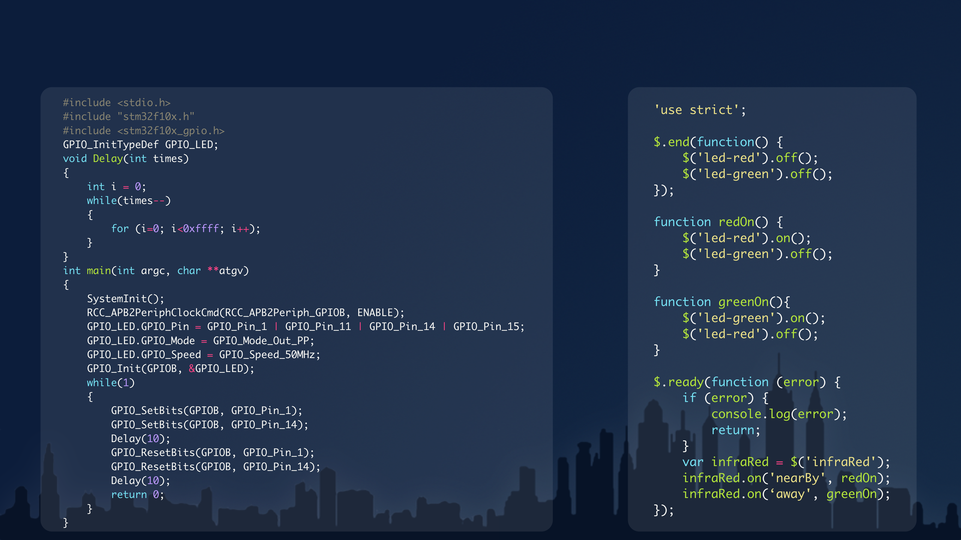
Comparison
Before Ruff
After Ruff

Slide 7
Ruff Supports
50+ Chipset series
ARM
MIPS
X86
xtensa
etc.
Major development boards
Ruff development board (Ruff official store)
Raspberry Pi (https://www.raspberrypi.org/)
WRTNode (http://www.wrtnode.com)
etc.

Slide 8
Ruff Supports (continued)
Complex network deployment
Gateway
Private Cloud
Public Cloud
etc.
IoT device control and deployment
Ruff Edge Server (RES) for Ruff and None-Ruff inside hardware
Sluff Technologies
Bridge IoT Application Store
etc.

Slide 9
Ruff Empowers
Software developers （Geeks / Hackers / Makers）
Rapid Prototyping
Numerous hardware solutions
Software distribution channels
Hardware solution partners
IoT applications and iterations
Interoperability between different hardware and networks
Business decision makers
Saves time, saves money!

Slide 10
Ruff in Action
Ruff on MCUs
RAM > 64kb
Production Support
Supply Chain Partners
Hardware Solution Partners
Ruff Solutions in different business sectors
Manufacturing
Energy Management
Ecological Protection
etc.

Slide 11
Questions?
http://www.ruff.io
jingtianwei#nanchao.org

